Slide 1
School Leadership Team Crimson Anisha Global School

Slide 2
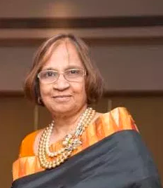
School Leadership Team
30+ years
Experience
National and international educator | Change maker | Pioneering new approaches in education
Expertise in school management, establishment, operations and teacher training
International Baccalaureate Representative for South Asia (1992 – 2009)
Joined IB in this position when the IB board was attempting to gain a foothold in the Indian Market and had only 2 schools in India offering their programmes
During her 17 year stint, the number of IB schools in India grew from 2 to over 150
Has been an Academic Advisor and Governing Council member of leading national and international curriculum schools (both in India and overseas).
Founding Member – South Asia IB Schools Association (SAIBSA is the only recognised association of IB Schools in India)
Vice President – Early Childhood Association and Assn of Primary Education and Research
Member - FICCI Alliance for Re-Imagining School Education (ARISE) | Association of ICSE Schools in Maharashtra (AISM) |
100+ Schools Mentored
15+ Schools Established / Managed
Farzana Dohadwala
Awards & Achievements
Lifetime Achievement Award (2018) for developing schools as per the IB philosophy by South Asia IB Schools Association
Innovative Teacher Award by Giants Group (2013)
Recognised as one of India’s top 50 educationists by Scoonews.

Slide 3
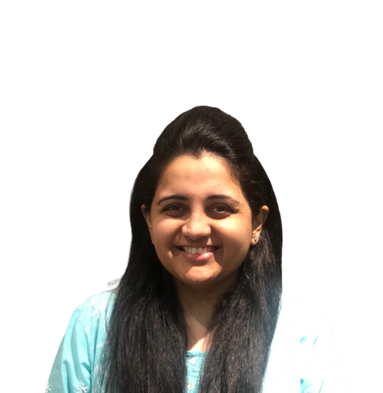
School Leadership Team
Experience
Ankita is the Managing Trustee of Anisha Education Trust and is an experienced professional in school operations.
Started her career as a passionate teacher of nursery students at Sanskriti School, Pune and underserved children at Punya Dham Ashram, Pune.
Completed her Bachelors in Business Administration from Symbiosis College, Pune before she moved to United Kingdom for pursuing her Masters in International Business from the Kings College.
Ankita is a social edu-preneur with a strong belief & values in creating impact on the lives of young children in the country. Entrepreneurship come naturally to her as she belongs to the Kolte-Patil group, which is a renowned, well established and trusted name in Real estate sector.
Ankita is actively involved in curriculum innovation and has a child-centred approach.
10 + years of experience
5+ Schools/
PreSchools Established & managed
Ankita Patil

Slide 4
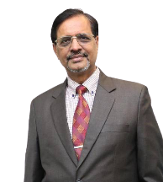
School Leadership Team
`
30+ years experience
Recipient of several awards including ‘National Award for Teacher’ by the President of India in 2012 and ‘CBSE Award’ (2009) for his contribution in Education and Community Development.
Former Chairman, National Progressive Schools Conference (NPSC).
Member of the Governing Body of the National Council of Teacher Education (NCTE), Government of India.
Member of the Governing Board, CBSE (Central Board of Secondary Education), Delhi
Listed by the Forbes India 2020 among the 100 Top People Managers, Ashok is a post-graduate in Physics from Allahabad University and in Consultancy Management from BITS, Pilani.
He has spent more than three decades in the education sector, pursuing innovative ways to impart knowledge, values and joy of learning.
He has been a successful school principal, author, speaker, researcher and facilitator. His book "Launch Your Inspiring Principal Leadership" is loved by the educators.
Extensively travelled to over twenty countries, Ashok led Indian principals' delegation to the University of Rice, USA, Institute of Leadership Nottingham, UK, Brisbane, Australia and Malta. He was the only school leader to participate in the Indo-Australian Leadership dialogue, Melbourne in 2018. Mr Pandey is SDGs evangelist and partnering with the UN’s #Act4SDGs initiative.
Dr. Ashok Pandey
Academic & Operations

Slide 5
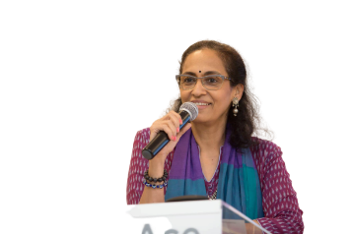
School Leadership Team
`
30+ years experience
Actress, Educationist, Researcher and expert in Life Skills curriculum
Selected among Top 10 finalists for the Global Teacher Prize among 10,000 teacher nominations from more than 179 countries worldwide.
Member, Central Advisory Board of Education, Government of India.
A Ph.D. degree holder in Education from the University of Worcester, England. She is also the first person to earn a Double Doctorate at the University of Worcester.
Winner of 1979 Miss India title and a popular face in the Indian cinema, she has been working relentlessly in the field of education.
Dr. Swaroop travels across India and conducts workshops for teacher and teaches acting to disabled children. She has done a commendable work in the states of Gujarat and Maharashtra in the field of education and was selected by the then Gujarat Chief Minister Narendra Modi to head an educational programme for children in Gujarat to teach life-skills in the government primary school.
In 2016 she was awarded Most Committed Person of the Year in Inclusive Education at the 4th International Early Childhood Conference.
She has also written a book titled Learning Disabilities in a Nutshell: Dyslexia, Dysgraphia, Dyscalculia, Dyspraxia. For the last few years, she has been training primary school teachers in Gujarat on using theatre as a means to develop life skills.
Dr. Swaroop Sampat Rawal
Life Skills Expert

Slide 6
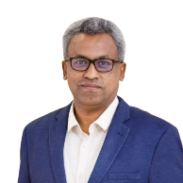
School Leadership Team
Experience
25+ years
India, Qatar, UAE, Kuwait
School Management Operations | Strategy & Organizational Development | Corporate HR
Been a COO of one of India’s largest chain of private schools
Former Head - Development & Strategy | Maharashtra International Education Board – Pioneering the establishment of a new education board in India (2017-2020)
Resource for establishing a New Education Board, Delhi Government (2020)
Evangelist in Education – Twitter India
Influencer of Policy recommendations/change for Govt. of Maharashtra
Coordinator, State International Curriculum Advisory Committee, Govt. of Maharashtra
Former Planning Committee member for online teacher education – Govt of Maharashtra
Think-tank team core member – Municipal Corporation of Greater Mumbai
Influencer in operational policies – CISCE (ICSE Board), CBSE, Cambridge and IB Boards
Former Core member of National Consultation on Government School Partnerships established by MHRD, Government of India (2018)
Core Lead – School Development & EdTech in 700 + Schools managed by Western Region Catholic Foundation for Education (Maharashtra, Gujarat & Goa)
Strong Network of relationship, Nationally and Internationally.
45+ Schools Established
110+ Schools Managed
Francis Joseph
Awards & Achievements
Top 25 Leaders Re-inventing Education in India, August 2020 by Education World
Certificate of Honour from Government of Maharashtra (2018)
Limca Book of Record (2013) for managing the fastest school admission process in Kutch (Gujarat). Received a letter of appreciation from Shri Narendra Modi, Chief Minister of Gujarat
Top Education Influencer award by ScooNews (January 2018)
Co-Founder of SLN Global Network
Vice-President of Early Childhood Association

Slide 7
School Leadership Team
Experience
15+ years of experience
Post Graduate Diploma in Management from IIM Calcutta, Certified Public Account (Delaware, USA), Bachelor of Commerce and Bachelor of Education (University of Mumbai)
Part of the IB Educator Network for the Asia Pacific Region (2013 – present) Youngest IB Head appointed by IB Educator Network. Has led school inspection visits, trained coordinators , helped schools during consultancy phase for the Diploma Program
Google Certified Educator – Have trained thousands of state board, national curriculum boards and international board teachers on how to effectively use technology in the teaching-learning process
Has led workshops for school heads and teachers on how to leverage the power of Twitter in schools and the classroom in collaboration with Twitter India.
Associated with multiple large private educational groups – as the Academic Director for their national and international schools for over 14 years .
Has also donned the role of a career coach and guidance counselor to help students with selection of appropriate pathways for further education after Class 12.
10+ Schools Established
10+ Schools Managed
Husien Burhani
Awards & Achievements
‘The Leaders-Pillars in Education Award’ by Education Today (2018)
Edupreneur of the year (2017) by Assocham (The Associated Chamber of Commerce & Industry India)
Award for Excellence in International School Leadership by India Today (2017)
‘Icon in International Education’ by the Honourable Education Minister (2017)

Slide 8
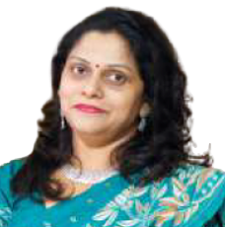
School Leadership Team
18+ years
Experience
Qualification includes PhD in Education in Multiple Intelligences – University of Mumbai, M.A (Eng.), M.Com, M.Ed.
Education Expert as a Teacher, Teacher Educator and Research Guide - Recognized Ph.D. guide (Education) by the University of Mumbai (MU)
Worked with schools in Mumbai and Kuwait
Chairperson for B.Ed. Credit Based Choice System Examination at MU and Convenor of Four-Year Integrated Syllabus
Authored 18 books – National and International Level including teacher resources for all grades published by Chetna Publications.
Trained 4000+ In-service teachers
Certificate from Wide World, Harvard Graduate School of Education, U.S.A. on completion of an online course on “Multiple Intelligences” and “Coach Development” with study groups from all over the world. (Scored points – 41 out of 45).
Completed 35 Online Certificate courses from International Universities.
Past Club President of National Soroptimist of India – a wing of SIGBI (Great Britain and Ireland).
Presented papers at National and International Conferences.
Leader – Teacher Education
Board of Studies Member University of Mumbai
Dr. Reni Francis
Awards & Achievements
Received a letter of appreciation (2013) from Shri. Narendra Modi, Chief Minister of Gujarat for authoring the book Blooming with Multiple Intelligence’s
Senior Woman Educator and Scholar Award (2017) by the National Foundation for Entrepreneurship Development
Academic Leadership Award (2017) by the International Institute of Organised Research
‘Acharya Devo Bhava’ Award (2016) by Brainfeed Magazine
Cover story was published in a monthly magazine “Kerala in Mumbai” for the June issue, 2017.

Slide 9
School Leadership Team
12 + years of experience
Experience
Began her journey as a Primary Teacher/Facilitator in Class 4 in 2007
Over the years successfully progressed as a Team Leader, Coordinator and a member of the School Pedagogical Leadership Team
Champions the cause of Community Service across the school that has resulted in the school being awarded for their work in this space (by Education World Magazine – 2019)
In the past 10 years has been associated with multiple leading national and international curriculum schools where she has led the early years and primary school academic programmes
Her forte lies in leading pedagogical training workshops for teachers, curriculum design and implementation
10+ Schools Established
10+ Schools Managed
Tasneem Dohadwala
Awards & Achievements
Certificate from the Limca Book of Records 2013
Innovative Teacher Award - the Giants Group of Byculla -2017

Slide 10
Thank you for being a part of our family

